Slide 1
Daisy Intelligence Hackathon 2020
Solution by Team Artemis
David Weitzenfeld
Lorna Licollari

Slide 2
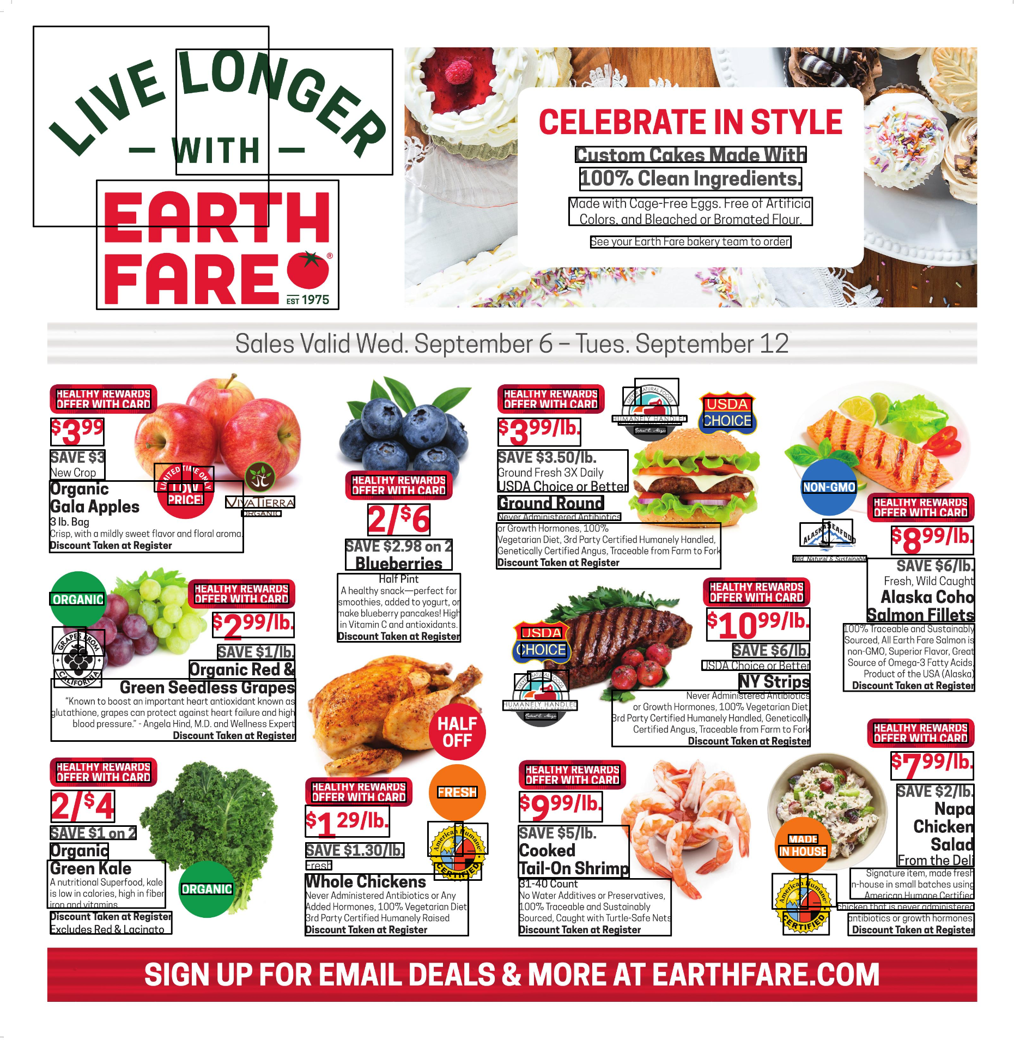
Step 1 OCR
Images are analysed for text using Google Cloud Vision API (OCR).

Slide 3
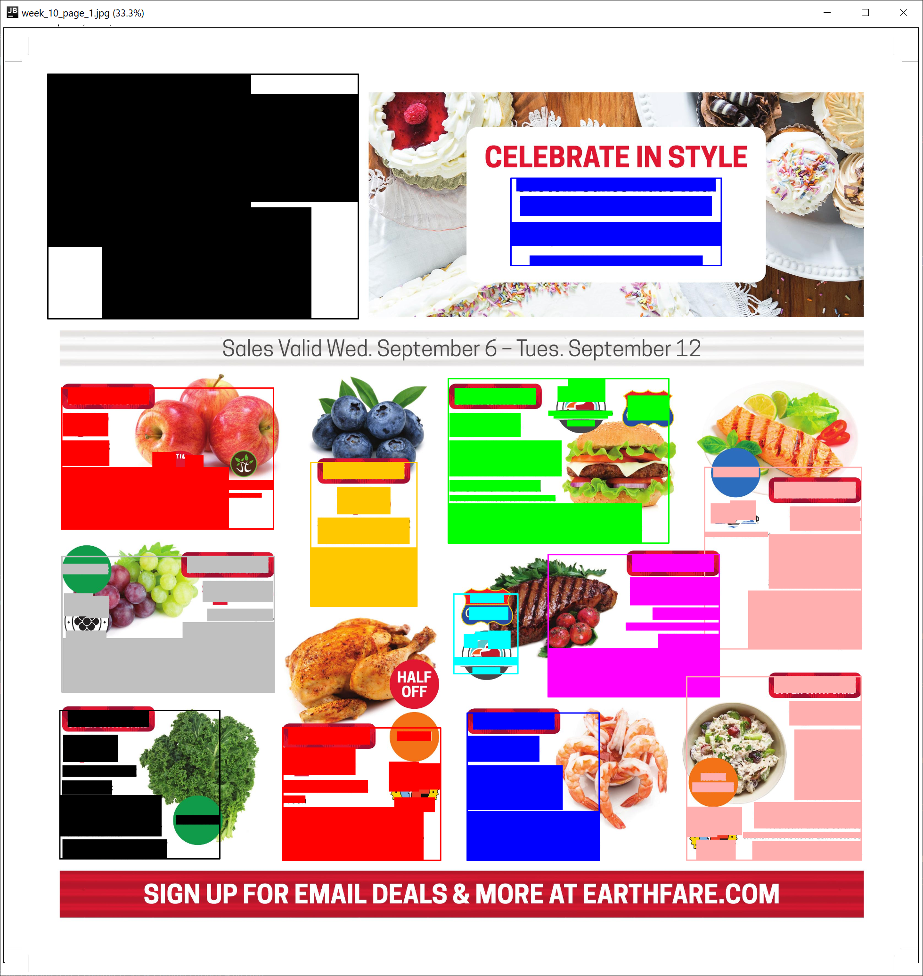
Step 2 Clustering
Text blocks are grouped using a custom clustering algorithm which makes use of the text alignment present in each ad-block.

Slide 4
Step 3 Cluster Refinement
Clusters are refined by drawing an outer rectangle around each one and forcing big clusters to “eat” small ones that fall in their domain.

Slide 5

Step 4 Information Parsing
Each cluster text is then analysed to extract the required fields based on string matching and patterns observed from the flyers.

